Slide 1

Neural Sentinel:
Decntralised, Deep learning based network intrusion detection solution
GROUP 4 MEMBERS:
YASH SHELAR
GAURESH BAGAYATKAR
VEDANT CHAUDHARI
OCEAN CHAUDHARY

Slide 2


PAGE 2
Introduction
With the growth of blockchain networks, security threats such as unauthorized intrusions have become increasingly sophisticated, challenging traditional detection mechanisms. The existing Intrusion Detection Systems (IDS) often lack the ability to adapt to evolving attack patterns and may suffer from centralized vulnerabilities or delayed responses.

Slide 3
PAGE 3
Literature survey
Deep Learning IDS (BiLSTM-based)
Recent research on BiLSTM-based and hybrid deep learning Intrusion Detection Systems (IDS) demonstrates improved detection performance by capturing both spatial and temporal network patterns.
Shortcomings of Existing Solutions:
High computational complexity limits deployment on resource-constrained IoT and edge devices.
Poor detection or high false positives for minority/rare attacks due to class imbalance in datasets.
Most models are tested on public datasets, lacking validation in real/production network environments.
Difficulty in extracting comprehensive spatiotemporal features; often neglect feature inter-dependence.
Vulnerability to adversarial attacks and evolving threat patterns not addressed in standard benchmarks.
Extended training times and complex architectures hinder real-time adaptability.

Slide 4

PAGE 7
Problem statement
This project aims to develop a decentralized IDS model leveraging deep Long Short-Term Memory (LSTM) networks for sequential anomaly detection, integrated with blockchain technology to provide tamper-proof incident logs and consensus-driven alert validation, ensuring accuracy, adaptability, and trustworthiness in dynamic blockchain environments.

Slide 5
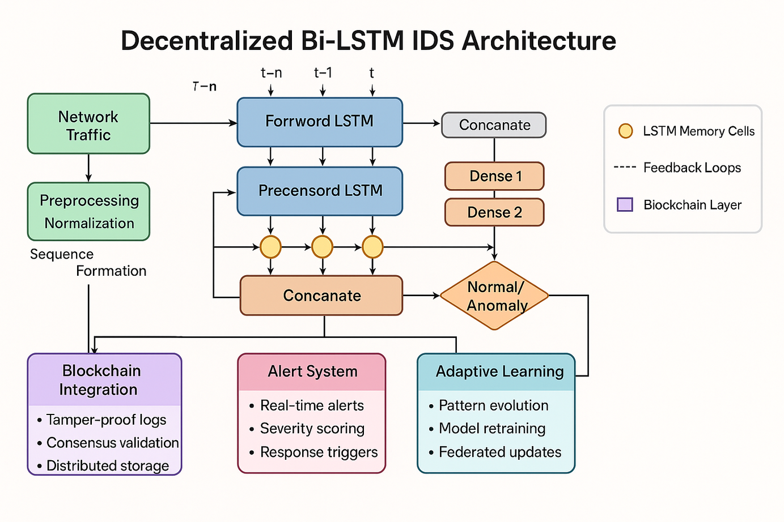
PAGE 4
FlowChart

Slide 6
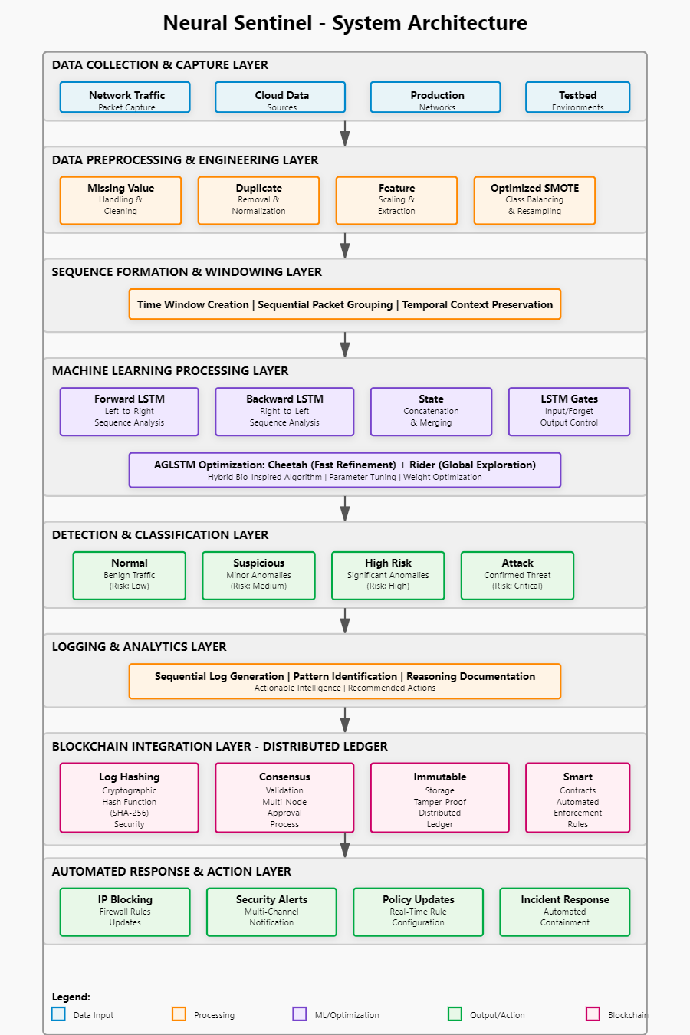
PAGE 4
FlowChart

Slide 7
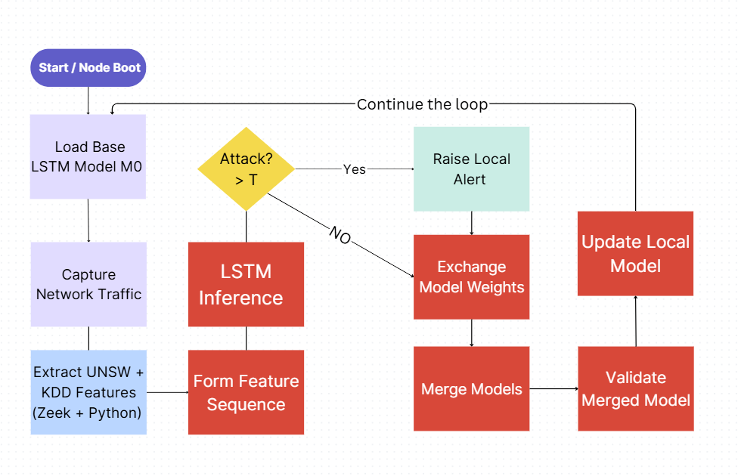
PAGE 4
Decentralized
flow

Slide 8
PAGE 8
NSL-KDD Network Security, Information Security, Cyber Security
The NSL-KDD dataset is a widely used dataset for evaluating and testing Intrusion Detection Systems (IDS). It is a refined version of the original KDD Cup 1999 dataset, which was used in a competition to detect network intrusions
Training: 134,677 sequences Testing: 22,535 sequences
Features: 40 Sequence Length: 10 flows
Attack Types (4):• DoS• Probe• R2L• U2R
Dataset details
UNSW_NB15
The number of records in the training set is 175,341 records and the testing set is 82,332 records from the different types
Training: 238,673 sequences
Testing: 82,323 sequences
Features: 44
Sequence Length: 10 flows
Attack Types (9):
• DoS • Reconnaissance
• Exploits • Fuzzers
• Backdoor • Shellcode
• Worms • Analysis • Generic

Slide 9
Performance Results
Metric
NSL-KDD
UNSW-NB15
Accuracy
77.95%
86.01%
Precision
97.25%
100.00%
Recall
63.05%
84.60%
F1-Score
76.50%
85.45%
🎯 Key Achievement: 100% Precision on UNSW-NB15 = Zero False Positives

Slide 10
Precision-Recall Trade-off Analysis
UNSW-NB15: Conservative Threshold Strategy
Precision: 100%
✓ Zero false positives
Recall: 84.6%
Trade-off Rationale
• Production IDS prioritizes alert quality over quantity
• 746 trustworthy alerts > 1046 alerts with 300 false positives
• Maintains analyst trust and prevents alert fatigue
Threshold Tuning Options
0.5 (current): Precision 100%, Recall 74.6%
0.4 (estimated): Precision ~97%, Recall ~82%
0.3 (estimated): Precision ~93%, Recall ~88%

Slide 11
Tamper-Evident Blockchain Logging
How It Works:
1. Detection Event Occurs Model flags suspicious sequence
2. Create Block
Package event data + metadata
3. Compute Hash
SHA256(index + time + prev + data)
4. Append to Chain
Atomic write to blockchain.json
5. Tamper Evidence
Changing any field breaks all subsequent hashes
Block Structure
{
"index": 42,
"timestamp": 1713187200,
"prev_hash": "a3f9d2...",
"data": {
"attack_type": "Recon",
"confidence": 0.934,
"src_ip": "172.20.0.4"
},
"hash": "7c4e1b..." }

Slide 12
PAGE 9
Research papers
Bi-LSTM for IoT Network Traffic Analysis
Goyal (2022) – Bi-LSTM on Blockchain Network Logs
Rauf et al. (2020)* – Distributed IDS using Multi-Agent Systems
Liu et al. focused on securing Internet of Things (IoT)*environments, which are notoriously vulnerable due to constrained devices and weak security protocols. Traditional IDS systems often struggle with identifying slow and stealthy attacks in such systems.
Goyal et al. explored how Bi-LSTM models could be leveraged to analyze *blockchain transaction logs* and detect malicious activities, such as double-spending, Sybil attacks, and suspicious smart contract interactions
Rauf et al. addressed the limitations of centralized IDS by proposing a *multi-agent system (MAS)* architecture tailored for distributed networks, such as peer-to-peer (P2P) or blockchain-based platforms.

Slide 13
PAGE 10
references
Bajpai SA, Patankar AB. Self-configuring intrusion detection using adaptive goal target optimization based deep Bi-LSTM in blockchain networking systems. Intelligent Decision Technologies. 2025;19(1):175-193. doi:10.1177/18724981251330736
M. Kumar and A. K. Singh, "Distributed Intrusion Detection System using Blockchain and Cloud Computing Infrastructure," 2020 4th International Conference on Trends in Electronics and Informatics (ICOEI)(48184), Tirunelveli, India, 2020, pp. 248-252, doi: 10.1109/ICOEI48184.2020.9142954.
V. Tomar and P. S. Mehra, "Deep Learning Bi-LSTM Model for Intrusion Detection in IoT," 2023 5th International Conference on Advances in Computing, Communication Control and Networking (ICAC3N), Greater Noida, India, 2023, pp. 1342-1347, doi: 10.1109/ICAC3N60023.2023.10541673.
K. RadhaKrishna, C. R. Babu, D. Abraham, P. K. Abhilash, H. M. Abbas and N. M, "Cyber Resilience in Smart Cities Using Bi-LSTM-Based Intrusion Detection System," 2025 International Conference on Computational Innovations and Engineering Sustainability (ICCIES), Coimbatore, Tamilnadu, India, 2025, pp. 1-7, doi: 10.1109/ICCIES63851.2025.11033050.
thanks

